Slide 1
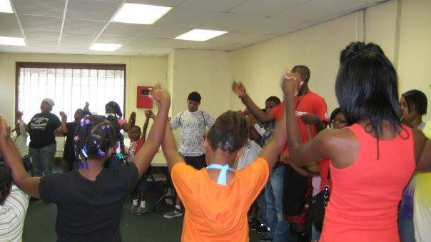
Successful Street Outreach
Presented by Ruth Standiford, B.A.
Social Worker
& Amir El Hajj Khalid A. Samad
Co-founder and Chief Executive Officer,
Coalition for a Better Life, dba Peace in the Hood, Inc.
99Treasures Arts & Culture, Inc.

Slide 2
About the Presenters
Amir El Hajj Khalid A. Samad, is an internationally recognized community activist
and expert on urban gang crime and violence intervention and prevention. His
honors are extensive, recognizing his almost 50 years in the struggle. He is the
cofounder Coalition for a Better Life, dba Peace in the Hood, Inc. which works with
gang involved and at risk of becoming gang involved youth and their families.
Currently, Peace in the Hood continues the work with our intergenerational,
multifaceted out of school time programming with 99 Treasures Arts & Culture, Inc.
Ms. Ruth Standiford has been with Peace in the Hood for 19 years. She is a social worker with the organization. She holds a bachelor’s degree from Tulane University in New Orleans and has done graduate work in the clinical doctorate program at Case Western Reserve University’s Frances Payne Bolton School of Nursing. She has been involved in all phases of community organizing and advocacy work, primarily child advocacy, for over 40 years in New Orleans, La. and in Cleveland.

Slide 3
Why We Need Street Outreach
“Ya’ll don’t know what it is like! You come to school
one day and everything is fine. You come back the
next day and the person on your right is dead and
the cops are looking for a person in the back for
killing him. How am I supposed to learn?”
……… Words from a 16 yr. old student following the murder of a classmate

Slide 4
Issues, Challenges and Opportunities with Street Outreach
BE PRO ACTIVE AND SOLUTION ORIENTATED
Youth gang crime and violence are at epidemic proportions and are threatening the health, safety and quality of life for communities and schools.
We are in danger of loosing a whole generation of young men of color either through death or incarceration.
Many youth are dealing with homelessness, addicted parents, human trafficking, broken families, failing schools, food insecure households,
Our youth are surrounded with a media culture of violence and degradation of women.
According to the Centers for Disease Control, the #1 cause of death for African American males from 1-44 is homicide. Many of the youth do not think they will live past 20, so they have lost hope.

Slide 5
A Brief History of The Coalition for A Better Life, dba Peace in the Hood, Inc.
Founded by Khalid A. Samad, the late Omar Ali-Bey and other community leaders in the late 1980’s to address the myriad of challenges facing urban America: racism, drugs, gang violence, police corruption, mis education and the absence of leadership, just to name a few.
This unified coalition of faith and community-based groups involved Muslims, Christians, Jews, Hebrew Israelites, liberals, conservatives, civil rights activists, human rights activists and community activists and cultural nationalists.
This level of cooperation, under Muslim leadership was unprecedented in America given this country’s history of inter-religious relations.
The coalition was recognized by the United States Congress and the White House as a national model for crime prevention and intervention.
The initiatives were holistic, culture specific and multifaceted and were community driven and many of them are still in place.

Slide 6
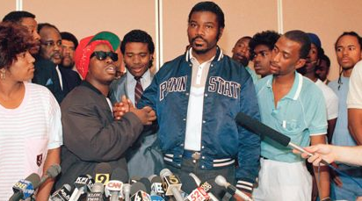
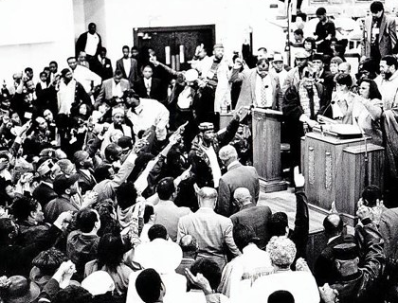

Slide 7
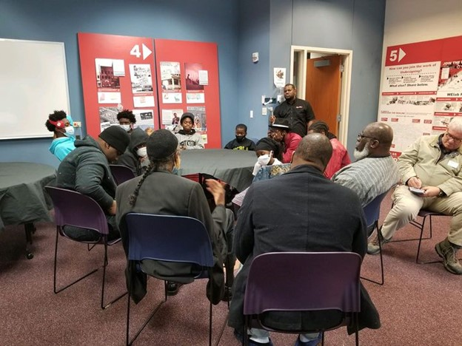

Slide 8
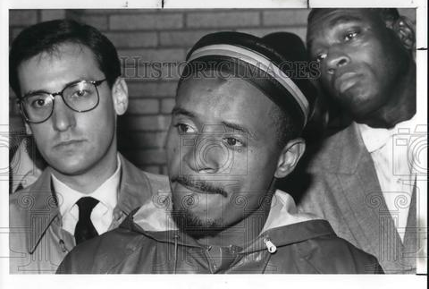
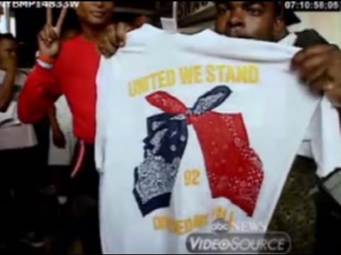
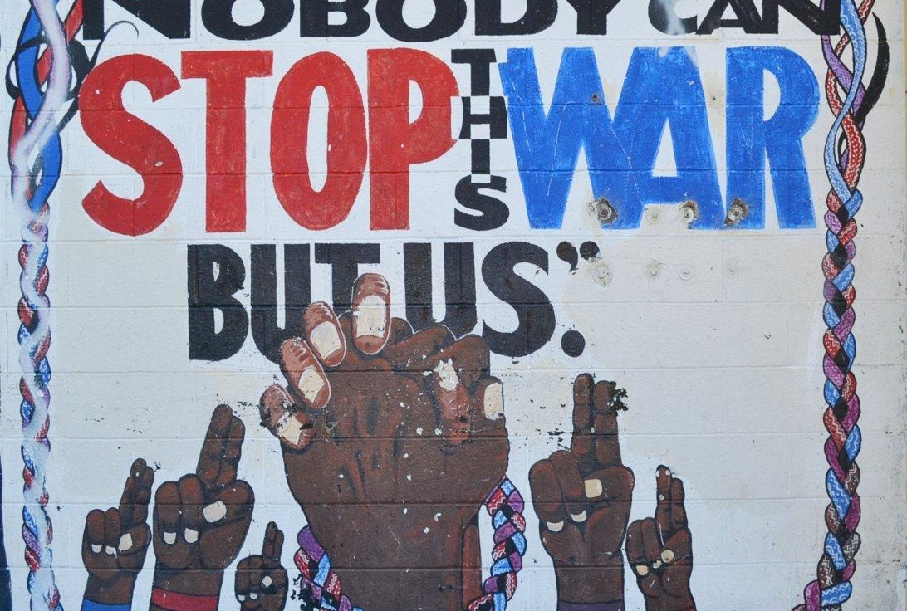

Slide 9
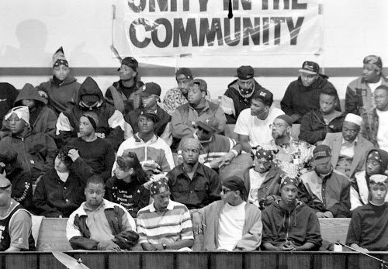
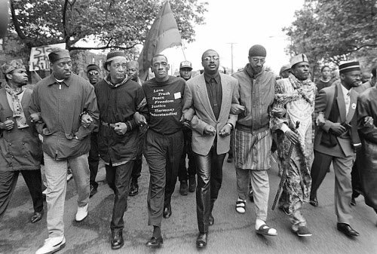

Slide 10
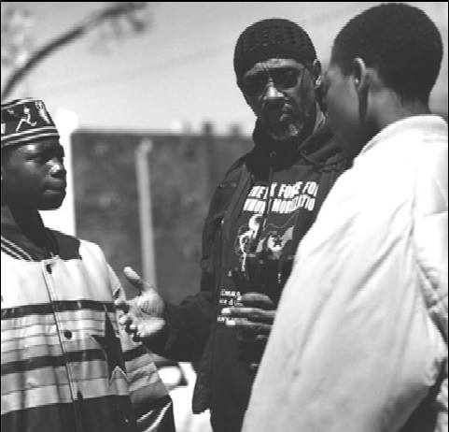
Continuing the Work Begun in 1992

Slide 11
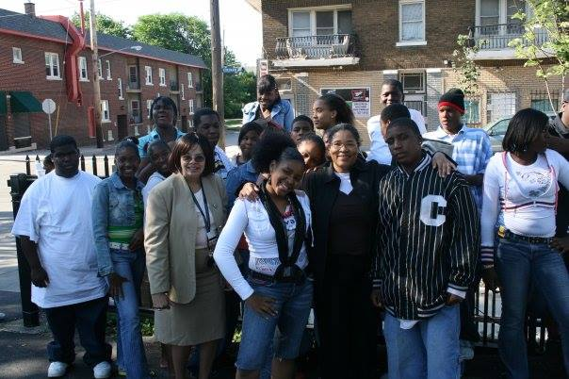

Slide 12
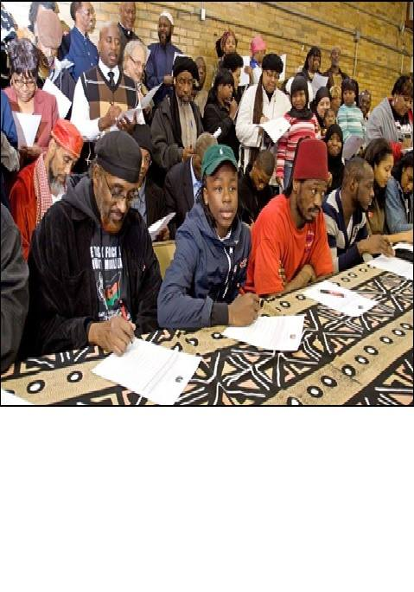
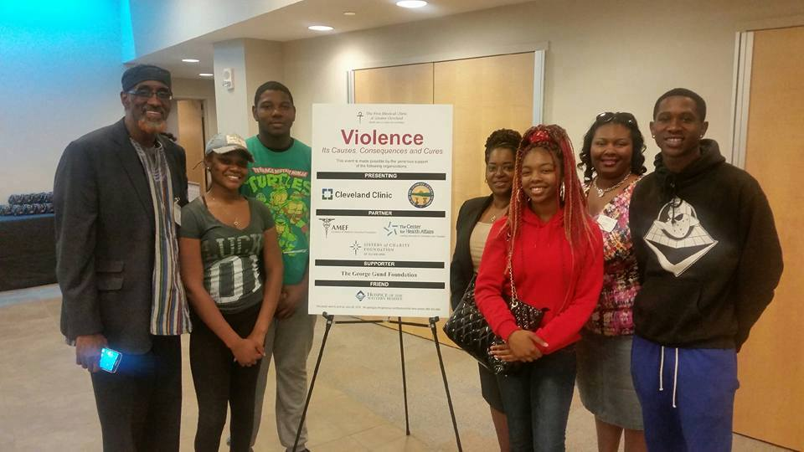

Slide 13
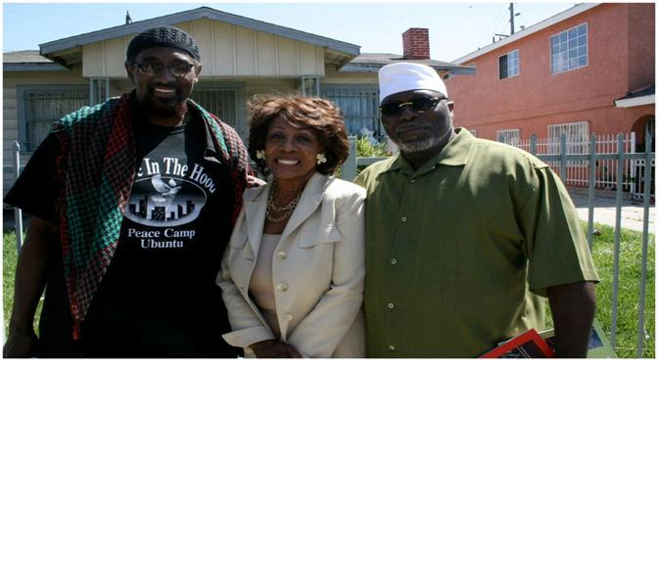
Boots on the Ground Nationally

Slide 14
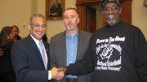

Slide 15
Lessons Learned
Keep it real……….youth can spot fake and phony in a heartbeat.
If you have overcome challenges in your life……..let them know. They need to know that it can be done.
Don’t “psychobabble” at them… youth are better at it than we are.
Talk WITH the youth and not at them.
Listen with all of your senses. Look behind their behavior to find out the “why”.
BE THERE to support youth when they are doing positive things. Our youth want our attention. Whether we give it to them for doing something good or something bad is our call.
Establish authentic collaborations with neighborhood organizations where the youth live. There is enormous work being doing in houses of worship, community programs and athletic programs that are not big-name programs but are there when something happens at midnight in the neighborhoods. You might be surprised at the professional qualifications of some of the people in these neighborhood organizations.
Work to strengthen the family. It does no good to just strengthen the youth if the family is unstable.
Let them know they HAVE choices AND with choice comes accountability.

Slide 16
Helping Victims and Family Members.
Every traumatic situation is different. Instead of saying “I know how you feel” try saying “I don’t know how you feel, but I know how I felt when it happened to me.”
There are no pretty words that can make trauma make sense, so do not even try. Let the family or the victim talk. Be present with them. Don’t judge what they say or how they say it.
Be there. Help them or connect them to support services that can help them with their needs.

Slide 17
Imagine…….
You are 15 yrs. old and have been in and out of foster care for most of your life.
Your mother is no where to be found and your father is incarcerated.
The streets and all that go with it, become your home. After getting out of the
juvenile detention center for the umpteenth time, they release you to your
grandmother. She cannot handle you and is tired of trying. She tells you to get out.
You have no one to sign for a work permit and no where to live, so you end up living
in the basement of an abandoned house with no heat, no food and no electricity.
You are trying to survive, so you go with a friend to rob someone, and you are killed
because the intended victim had a CCW. What would YOU have done to try to survive?

Slide 18
99 Treasures Arts & Culture, Inc.
MISSION STATEMENT
Our mission is to provide Arts and Culture awareness to the underserved African American community, S.T.E.A.M. through art, artistic skill development, entrepreneurial training, reading and life skills. In addition, host events and special programs to help gain exposure for individuals in the community.
VISION STATEMENT
Our vision is to be a socially active, community-based organization that is committed to the optimal well-being of our community.
This is accomplished through our intergenerational multi-faceted curriculum.
Through the arts we will enrich the quality of life for talented and emerging artist/entrepreneurs in our community.

Slide 19
Addressing Crime, Violence and Solutions through Art

Slide 20
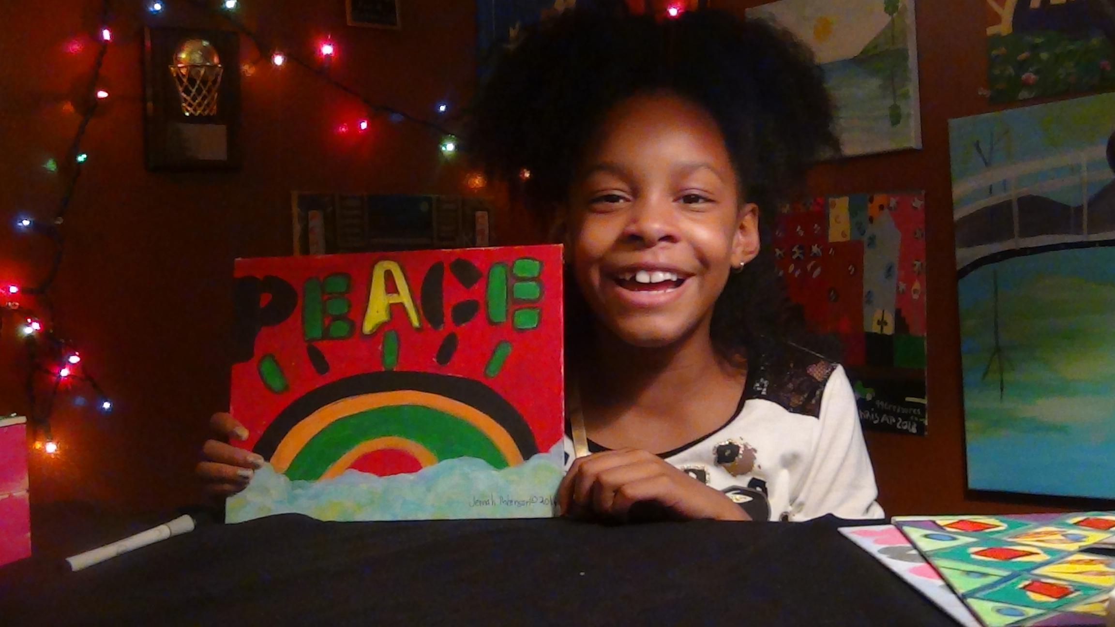
All aspects of our curriculum include “S.T.E.A.M.”: the arts, humanities, language arts, dance, drama, music, visual arts, design and new media.
Unity Circles: To discuss current issues in the community, at school and home. Holistic Solutions for Holistic Problems. Drugs, crime and violence (workshops)
Cultural Awareness: African American history, drumming, spoken word and dance.
Summer Camp
Life Skills, Entrepreneurship and financial literacy and much more.

Slide 21
To Refer a Client to 99 Treasures Arts & Culture, Inc.:
By email: coalitionforabetterlife@gmail.com
99Treasures@gmail.com
Call or text Sis Raj at (216) 618-8806
Follow us on FB: Peace in the Hood
Peace in the Hood Community Page
99 Treasures International

