Slide 1
AGENCY OVERVIEW
Myesha Watkins
Executive Director
7/22/2022

Slide 2
WHO WE ARE
Cleveland Peacemakers Alliance (CPA) seeks to empower communities to live in peace before resting in peace.
Our focus is to foster
supportive environments and healthy conditions to reduce violence effectively.
Committed to providing community - led prevention, intervention, and restoration services to those who desire to live a violence-free lifestyle.
Cleveland Peacemakers Alliance (CPA) is a non-profit 501(c)(3) charitable organization.

Slide 3
WHO WE SERVE
Youth & Young Adults 14-24
At high-risk for being impacted by violence
Already encountered or engaged in experiences of violence
Cleveland Residents

Slide 4
WHAT WE DO
Prevention
Assist youth and young adults ages 14-24 in building protective factors to reduce becoming victims or actively involved in violence.
Services include:
1:1 Mentorship
Workforce Development
Interactive Programming
Notes:
1:1 Mentorship – Each participant is assigned a CPA Worker to provide positive adult interaction, a trusted voice of reason, and accountability.
Workforce Development - Employee-eligible participants receive help in obtaining job readiness skills, leads for position openings, transportation support, and additional resources.
Interactive Programming - Participants engage in meaningful activities that highlight creative expression, social-emotional development, and positive decision-making. Such programs may utilize art, music, and recreational sports as avenues to gain rapport and teach concepts.

Slide 5
WHAT WE DO
Intervention
Work to intervene and mediate conflicts to provide immediate support for individuals at high risk of becoming involved in gun violence. Interventions may be through community, court, or hospital support.
Services include:
Community - CPA participates in safe passage for schools, hotspot monitoring, and authentic engagement.
Court - Our team works with court-involved participants.
Hospitals - CPA responds to victims of violence taken to Metro Health & University Hospitals Level 1 Trauma Centers.
Notes:
Community - CPA participates in safe passage for schools, hotspot monitoring, and authentic engagement. We immediately deploy to scenes where gun violence has occurred to provide support to those closely impacted by identifying concrete needs for safety and de-escalation. Our team intervenes through building trust, hope, and rapport with community members through candid conversations, interpersonal skills, information dissemination, and community service.
Court - Our team works with court-involved participants to reduce recidivism, navigate the system with a better understanding, and complete mandated supervision requirements.
Hospitals - CPA responds to victims of violence taken to Metro Health and University Hospitals Level 1 Trauma Centers. Our team provides a presence to reduce retaliatory actions following an act of violence and gather information from friends and family to best identify and support their current safety needs.

Slide 6
WHAT WE DO
Restoration
Encourage persons impacted by violence to create new paths towards success through engaging in positive peer association, prosocial behaviors, and restorative practice.
Our team stays connected to those experiencing pain and their families to provide support services and ongoing resources.
In a death, CPA will assist with planning funeral arrangements, vigils, or other means of honor and reflection.
Notes:
Cleveland Peacemakers Alliance (CPA) encourages persons impacted by violence to create new paths towards success through engaging in positive peer association, prosocial behaviors, and restorative practice. Our team stays connected to those experiencing pain and their families to provide support services and ongoing resources. In a death, CPA will assist with planning funeral arrangements, vigils, or other means of honor and reflection.
We recognize the importance of community partnerships and are committed to working closely with others to increase impact and relevant connections for those in need.

Slide 7
TRAUMA CENTERS
METRO HEALTH HOSPITAL
UNIVERSITY HOSPITAL
REFERRALS
COMMUNITY
COURT SYSTEM
TRAUMA UNITS
LAW ENFORCEMENT

Slide 8
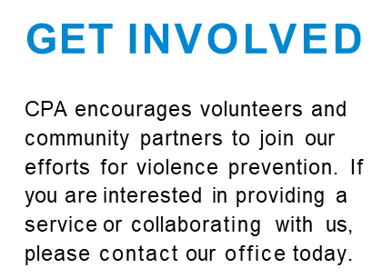
CONTACT US
5644 Broadway Avenue
Cleveland, OH 44127
(216) 243-7002
info@clevepeace.org
Follow us! @ForPeaceCleve

